Slide 1
Team 17
Sprint 2 Presentation

Slide 2
Presentation outline
Presentation will be around 15 minutes
15 minutes at the end for questions
Please feel free to stop me at anytime for clarification or other questions
Let me know if anything is hard to see over the screen share, we can always open up the relevant document to zoom in

Slide 3
Topics we will be covering
Project outline
Current project backlog
Sprint 2 Summary + retrospective overview
Risk management plan
UI Prototype showcase
Architecture review + tech stack
Testing plan
Live demo
Sprint 3 planning
Questions?

Slide 4
Project Outline

Slide 5

Our Application

Slide 6
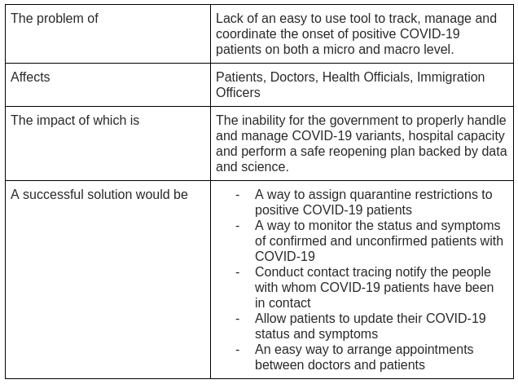
Our problem statement

Slide 7
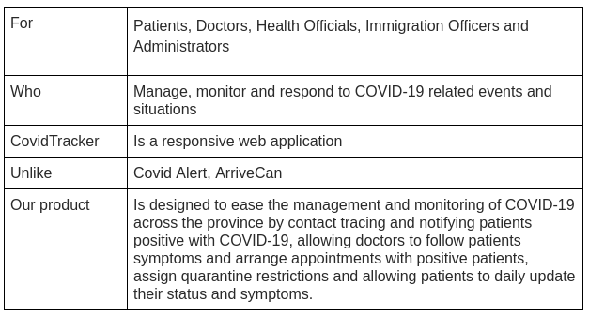
Product position statement

Slide 8
Current project backlog

Slide 9
Current project epics
Patient Management
Status Management
Contact Tracing
Appointments
Messaging System
Notification System
QR Code System
Authentication and Authorization
Project Setup
Project Infrastructure
Documentation
**View individual user stories from the backlog in the document submitted**

Slide 10
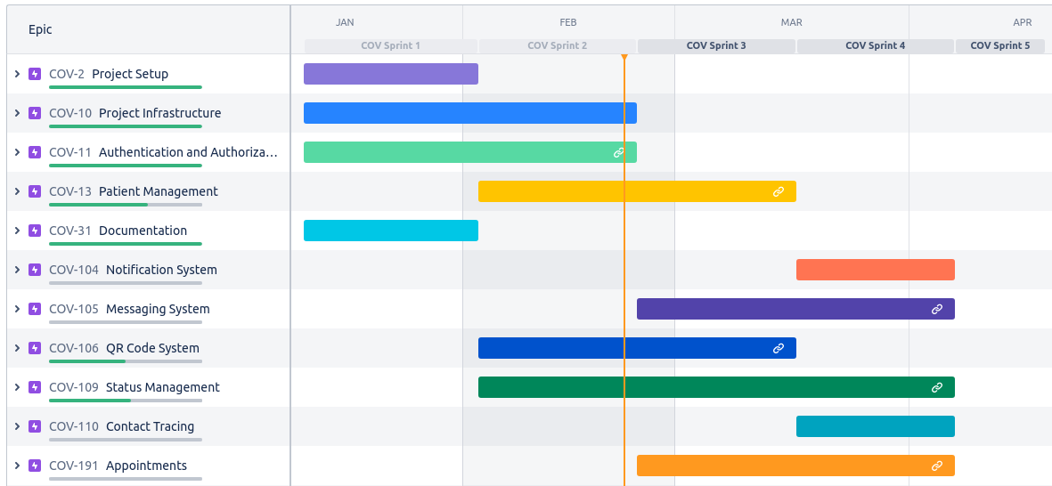
Progress in project

Slide 11
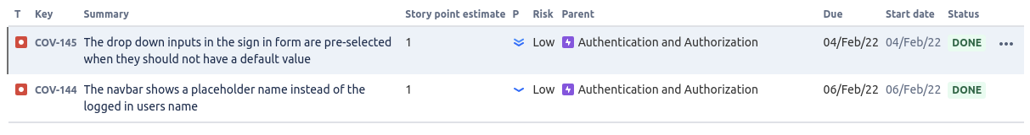
Defect tracking report
Total number of bugs: 2
Number of resolved bugs: 2

Slide 12
Sprint 2 Summary + retrospective overview

Slide 13
Our focus for sprint 2
Start building the core flows for patient and status management
Expand out the UI mockups for sprint 3 and refine user stories for sprint 3
Reached our commitment of 73 points and closed all issues in the sprint

Slide 14
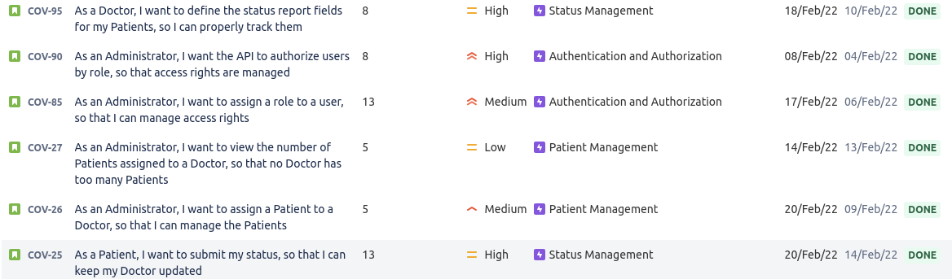
User stories completed

Slide 15
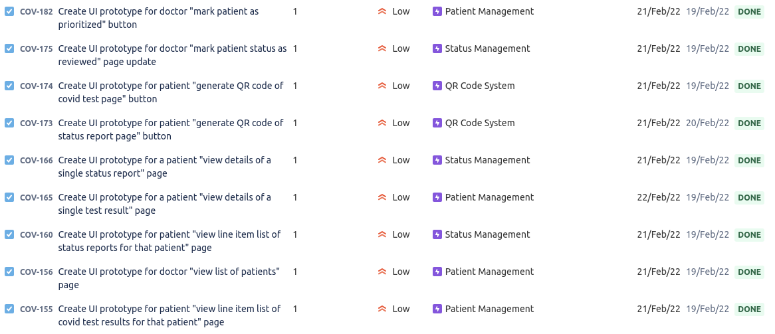
Tasks for UI mockups and prototypes

Slide 16
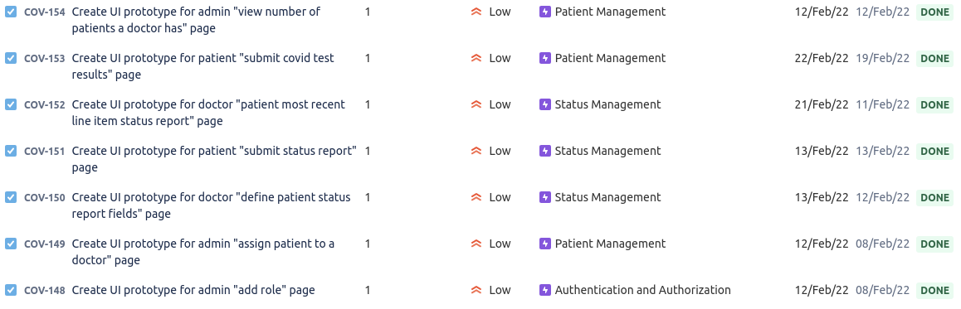
Tasks for UI mockups and prototypes cont.

Slide 17
Tasks for Project Infrastructure

Slide 18
Bug / defect fixes

Slide 19
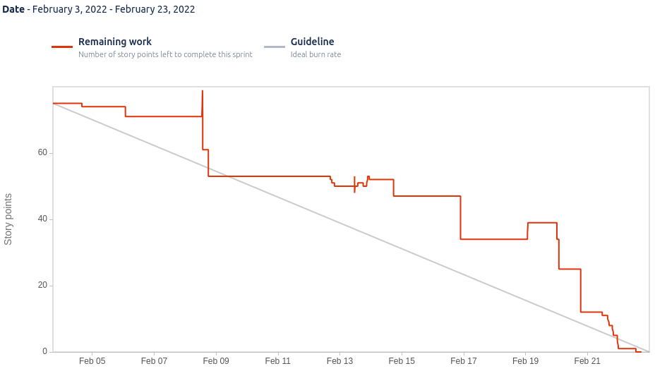
Burndown chart

Slide 20
Project velocity after sprint 2
Velocity = 64.5 USP
Velocity should continue to increase slightly but cap off around 70 USP maximum velocity +-5 USP

Slide 21
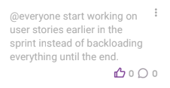
Our actions item(s)

Slide 22
Risk management plan

Slide 23
Identified risks
We have identified 10 different risks for our project, all are documented in the submission.
The new risk identified in sprint 2 is related to the Authentication and Authorization epic

Slide 24
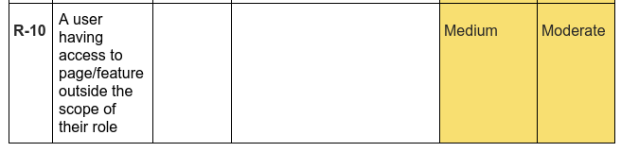
Risk(s) identified in sprint 2

Slide 25
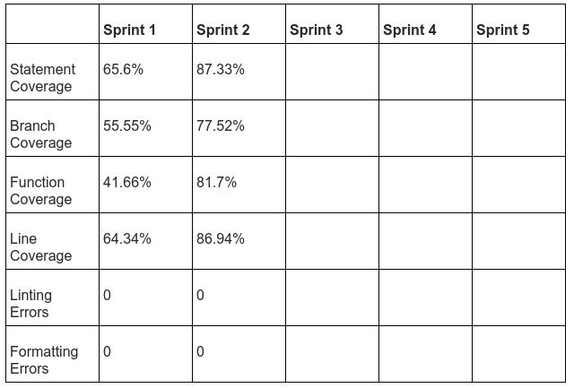
Update on quality metrics

Slide 26
UI Prototype showcase

Slide 27
Let's go into Figma and see the UI mockups and interactive prototypes

Slide 28
Architecture review + tech stack

Slide 29
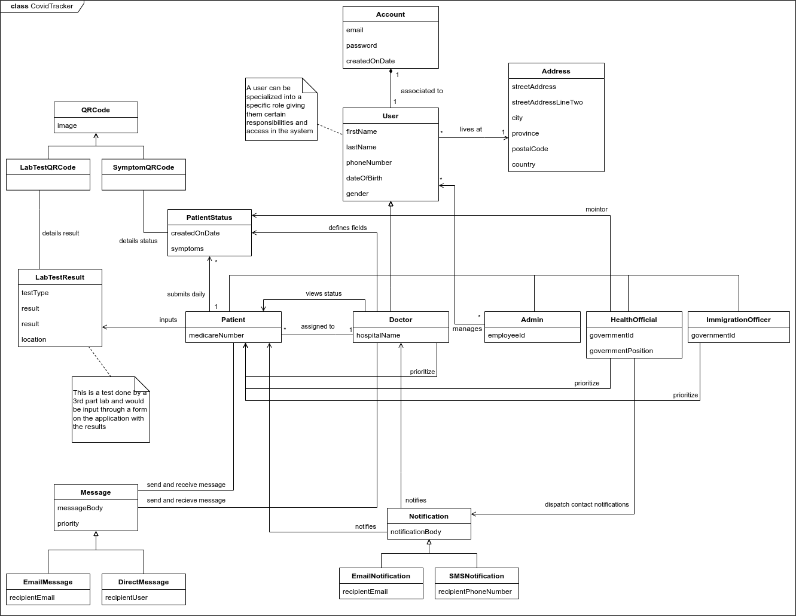

Slide 30
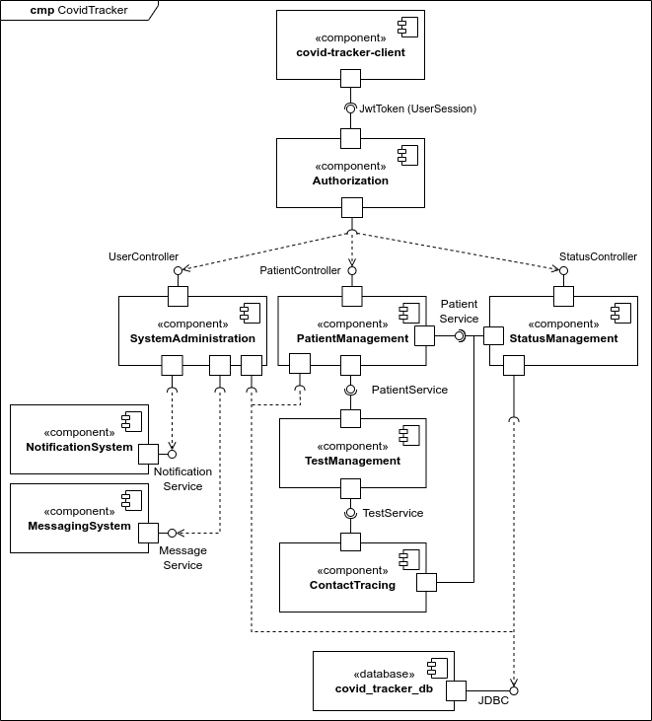

Slide 31
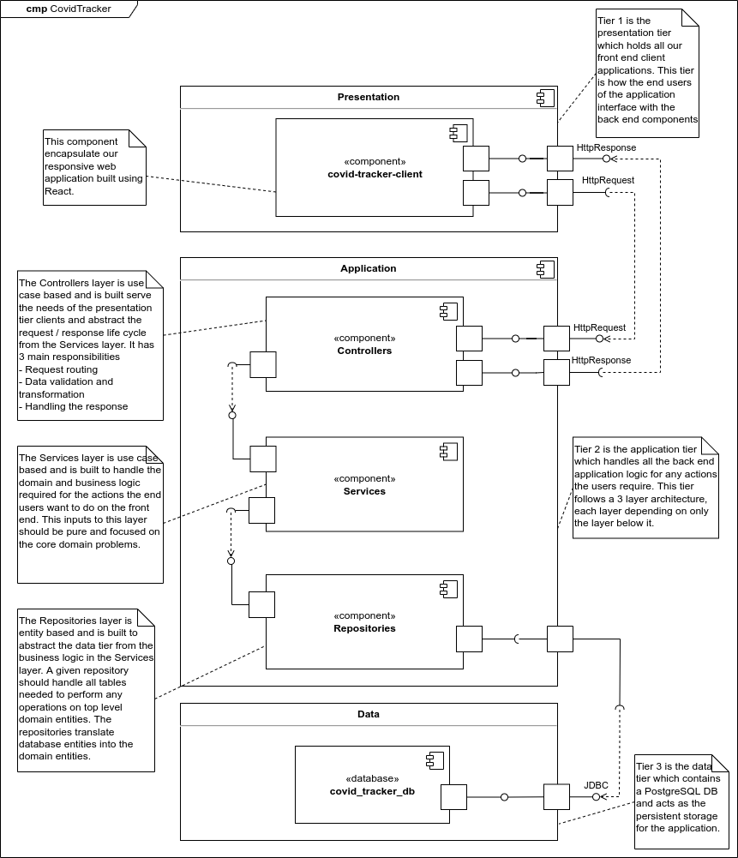

Slide 32
Everything is on Docker
All services (client, server, and database) are running on docker
We use docker-compose in our development environments in order to orchestrate all required containers for build, run, log, and teardown actions

Slide 33
CI/CD pipeline using GitHub Actions
We have a CI pipeline setup right now which will evolve into a CI/CD pipeline
Where CI = continuous integration and CD = continuous deployment
The pipeline runs on every pull request and commit to main (pr merge) and will block if any step doesn’t pass
Our pipeline runs
Build
Lint
Format
Test

Slide 34
Testing plan

Slide 35
Our testing plan
We have identified 4 types of tests for our system
Unit tests
Integration tests
System tests
Acceptance tests
Most are automated some are manual
Some have output reports
**More about the specific packages we use for our testing framework and a comparison between all of them can be found in the document**

Slide 36
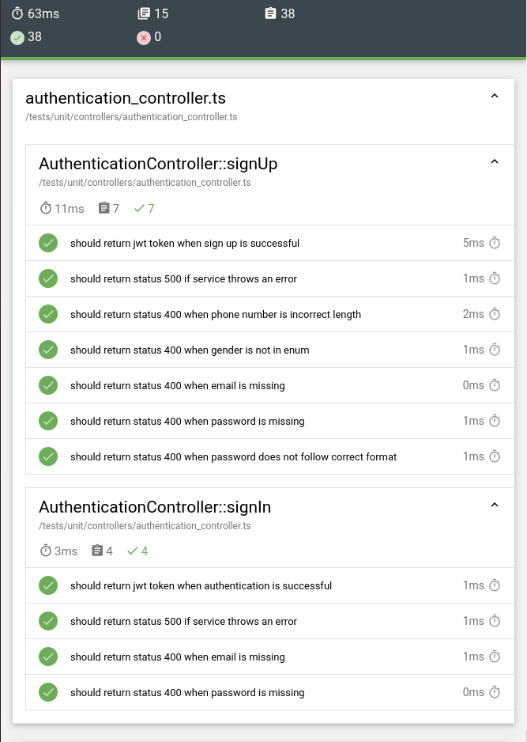
Unit test report
38 unit tests
15 test suites
0 failures

Slide 37
Code coverage with unit tests
We can generate code coverage reports for both the front end and server side using the appropriate libraries

Slide 38
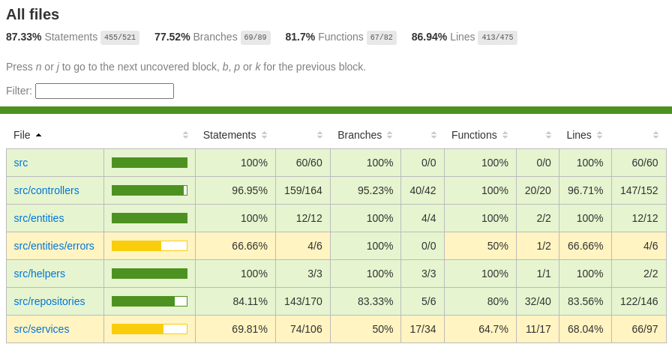
Code coverage report

Slide 39
Integration tests
Our integration tests are automated tests
The tests use a full PostgreSQL DB instance running in docker
We have written db initialization and seeding scripts to help scaffold the tests

Slide 40
System Tests
Run manually
Can be automated but not on our roadmap
Tests the systems functionalities end-to-end
Format is steps / action for the tester to perform and the associated outcome for each
System tests for each user story can be found in the submission document

Slide 41
Acceptance Tests
Run manually
Can be automated but not on our roadmap
Tests the system according to the requirements
For use this means they are derived directly from our user stories
Format is Gherkin Syntax which is a behavioral driven development (BDD) syntax that allows us to define our tests in terms of user state and behavior
Acceptance tests for each user story can be found in the submission document

Slide 42
Live demo

Slide 43
Sprint 3 planning

Slide 44
What’s next in sprint 3?
Our focus will be on delivering
Adding more actions and views for patient and status management
QR Code generation of status and test results
Start work on refining and delivering the mockups for appointments, messaging, and contact tracing
Sprint 3 contains 70 story points, which is slightly higher than our project velocity
One of our main goals is to start working on the front ends sooner in the sprint which will allow us to get quicker feedback

Slide 45
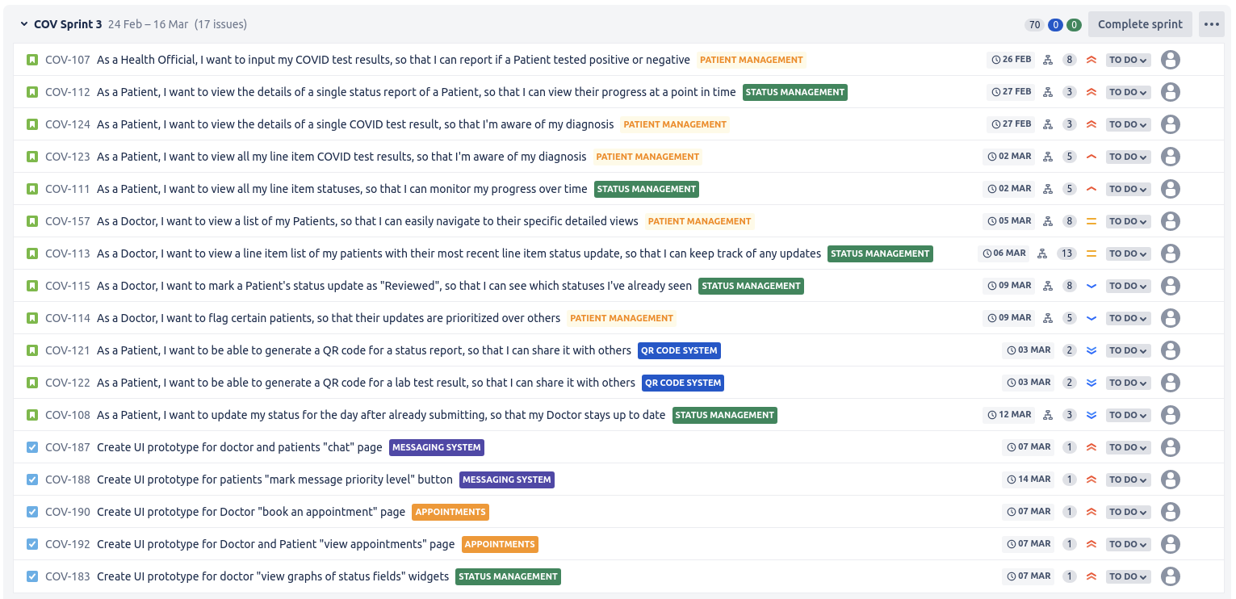

Slide 46
Questions?

